Slide 1

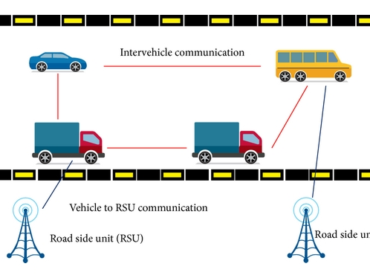
Privacy preserving mechanism for secure data exchange in vanetS
By:- Mani Dhiman
Admission No:-23022158
Uni Roll no:-2023439
Mentor:- Mr. Rohan Verma (Assistant Professor)
Section :- a
Class Roll No. :- 36

Slide 2
OUTLINE
Introduction
Problem Statement
Methodology
Results and Discussion
Conclusion and Future Work

Slide 3
INTRODUCTION
VANETs aims to ensure safe communication by improving the security and privacy and therefore significantly reducing unsafe communication. This project ensures the safety of users data while communicating with other vehicles and users.
Due to the difficulties of using a real time execution due to authentication and privacy issues, several majors are taken to provide the wireless network for smart data and information exchange between users while ensuring privacy of users using VANETs .

Slide 4
PROBLEM STATEMENT
As vehicles increasingly rely on VANETs for communication, the privacy and security are seen at higher risks. The data or information exchanged by vehicles and users such as location, traffic, data and all can be easily exposed to malicious hackers.
If the information is not guarded then it could be exploits for tracking, monitoring or breaching the privacy of user or vehicle.
This project mainly focuses on the need to protect driver information while also considering and facilitating effective vehicle-to-vehicle communication.

Slide 5
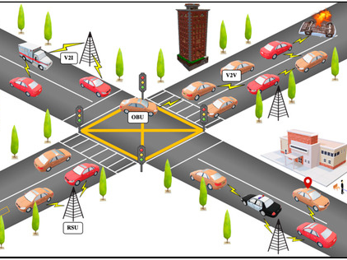
Methodolgy
This project focuses on designing a privacy-preserving mechanism for secure data exchange within Vehicular Ad-Hoc Networks (VANETs) using SUMO (Simulation of Urban Mobility) and Python. The objective is to protect sensitive vehicle information such as location, speed, and trajectory while ensuring privacy through pseudonym-based methods and secure communication techniques.

Slide 6
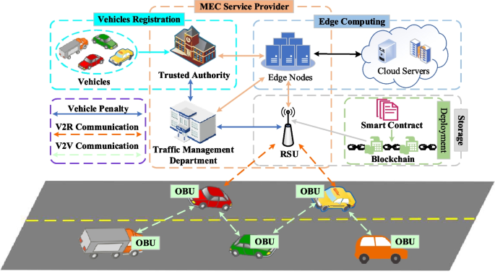
Components of methodology
System Architecture
Cryptographic Techniques for Secure Data Exchange
Pseudonym Management
Secure Message Transmission
SUMO Simulation for Vehicle Mobility and Traffic Flow
Python for Cryptographic Operations

Slide 7
Results AND DISCUSSIONS
The proposed simulation successfully demonstrated the effectiveness of a privacy-preserving mechanism for secure data exchange within Vehicular Ad-Hoc Networks (VANETs).
The experiment focused on encrypting and digitally signing vehicle messages, simulating their movements, and verifying data integrity across all vehicles involved.

Slide 8
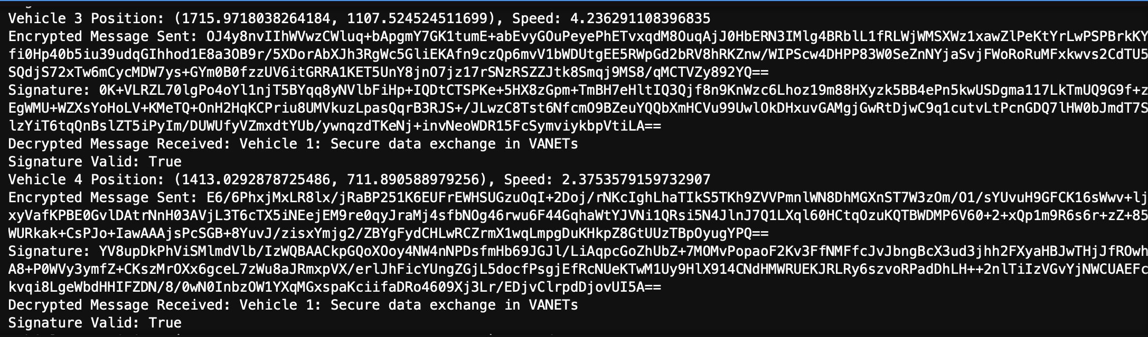
results
Encrypted message exchange
Data integrity verification
Vehicle Movement simulation using SUMO
Performance and efficiency for smaller networks
Safeguarding sensitive vehicle data
Output of project

Slide 9

Conclusion and future work
This project investigated privacy-preserving mechanisms for secure data exchange in VANETs using cryptographic techniques to ensure data integrity and authentication. Simulations with SUMO and validated the feasibility of these protocols, demonstrating secure communication between vehicles without compromising network performance.
Future research could explore advanced cryptographic techniques like homomorphic encryption and integrate machine learning for anomaly detection. Real-time testing with 5G, blockchain, and real vehicle data could enhance scalability and privacy in VANETs.

Slide 10
References:
https://www.researchgate.net/publication/327366416_A_Research_Paper_on_Vehicular_Ad-Hoc_Network
https://www.sciencedirect.com/science/article/pii/S2352864818303092
https://journal-bcs.springeropen.com/articles/10.1186/s13173-021-00113-x
omnetpp
https://eclipse.dev/sumo/
https://github.com/sommer/veins

Slide 11
THANK YOU!!

